Slide 1
BIO 410/510: Data analysis and visualization
Lauren Hallett

Slide 2
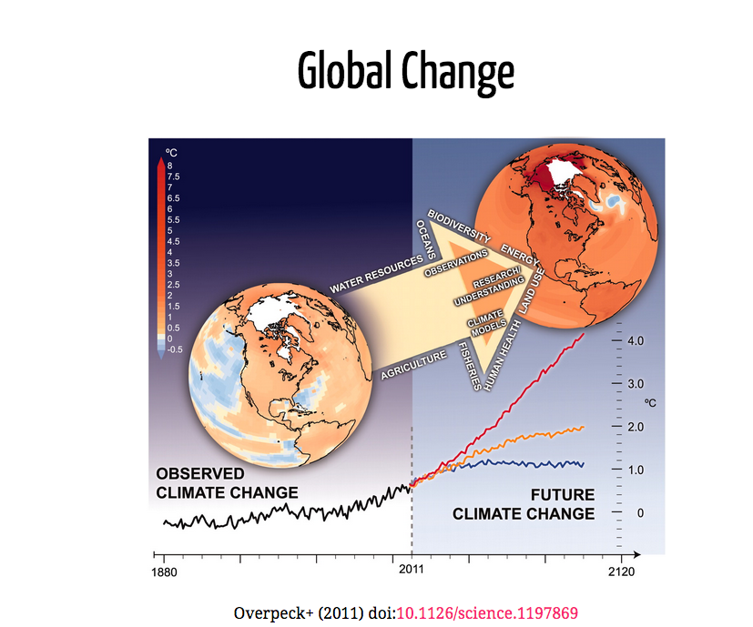

Slide 3
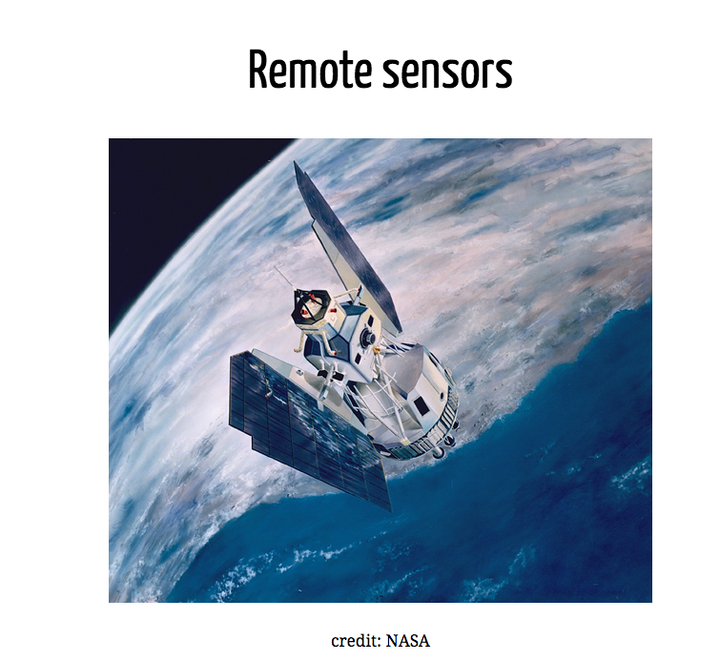

Slide 4
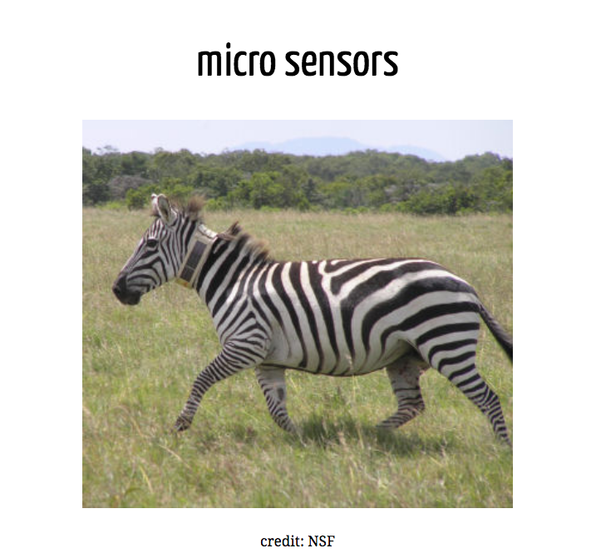

Slide 5
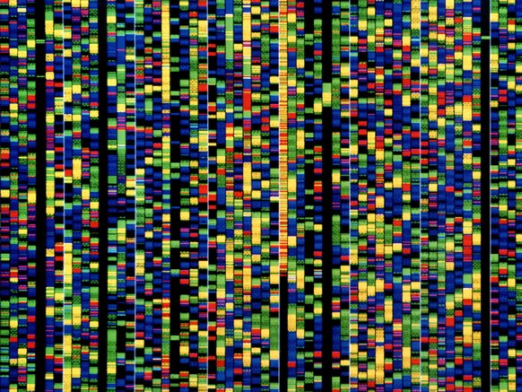
Genetic and molecular
credit: David Parker

Slide 6
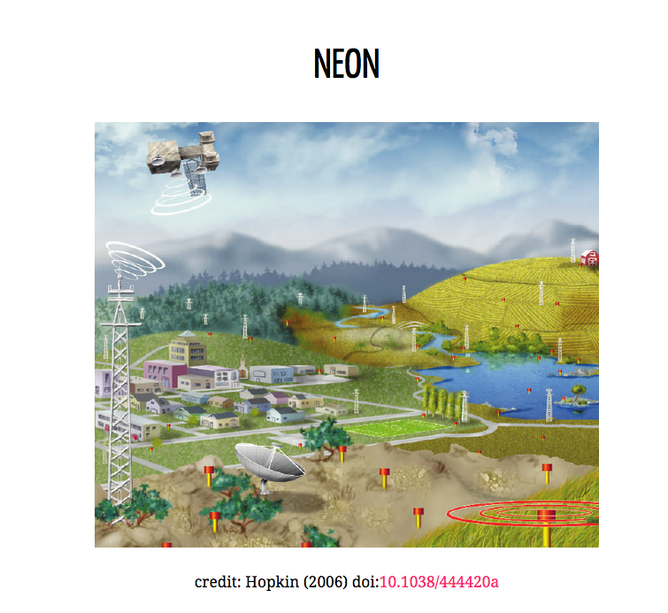

Slide 7
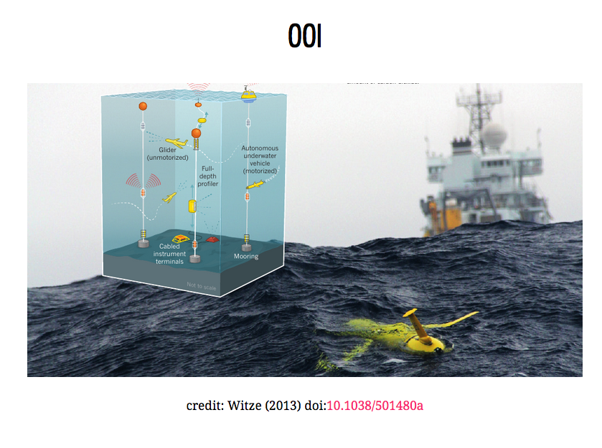

Slide 8

GenBank

Slide 9
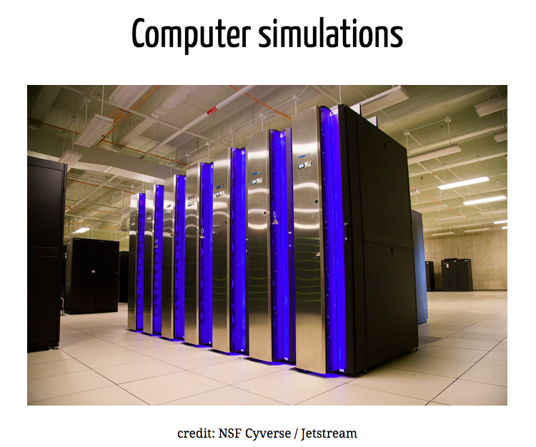

Slide 10
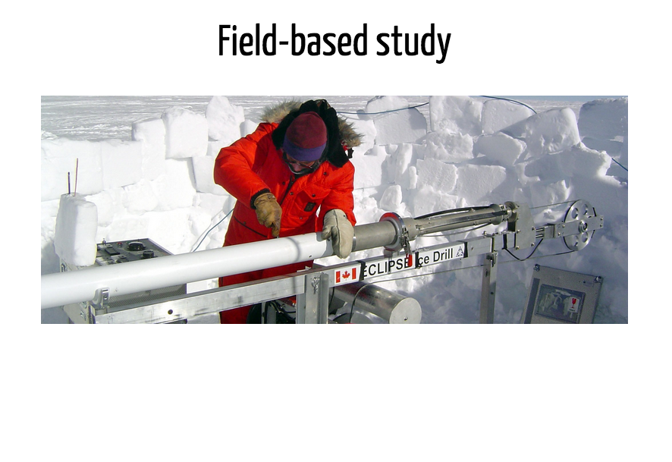

Slide 11
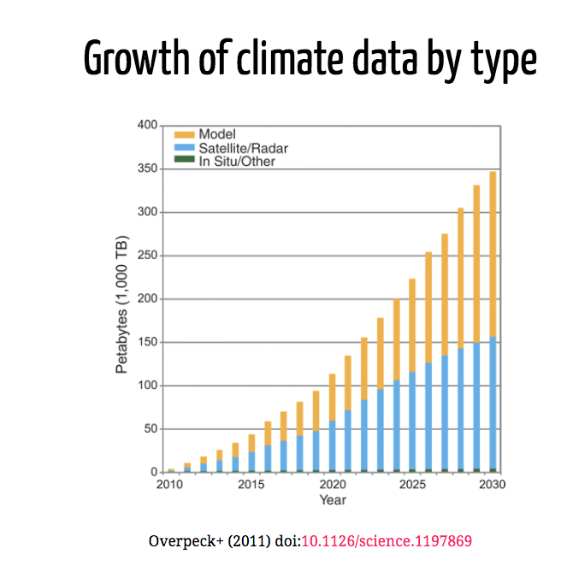

Slide 12
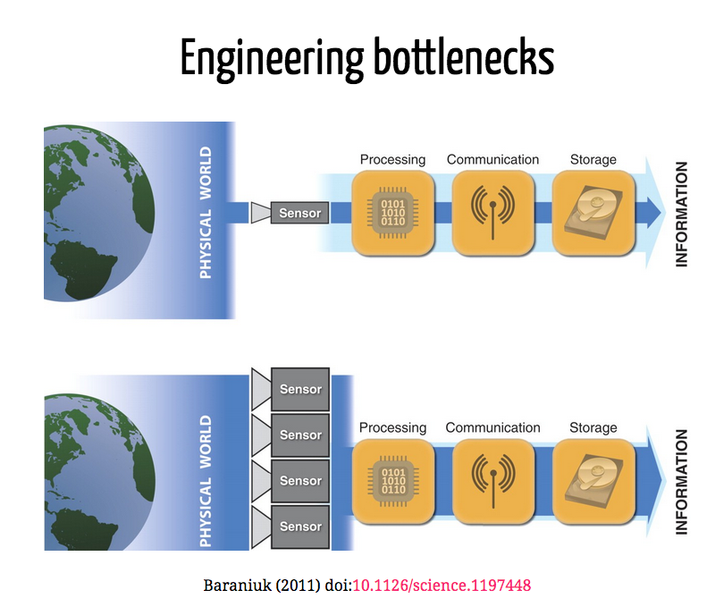

Slide 13
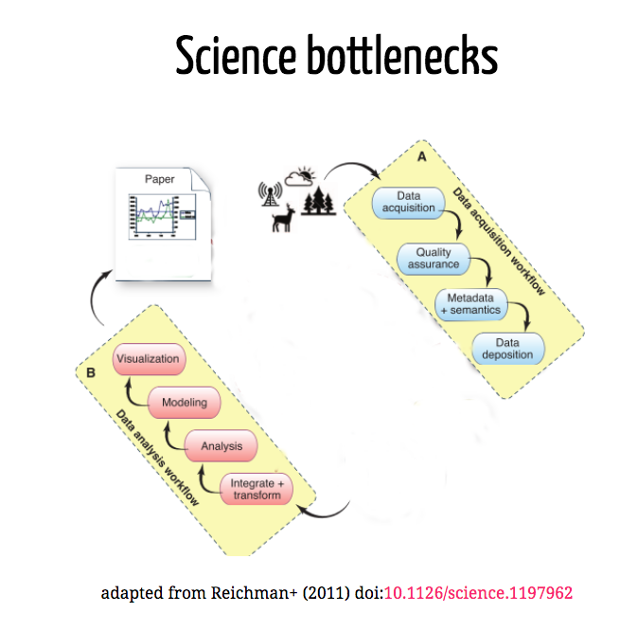

Slide 14
Our focus is on these Science bottlenecks

Slide 15

Course content: data life cycle
Wickham and Grolemund R for Data Science

Slide 16
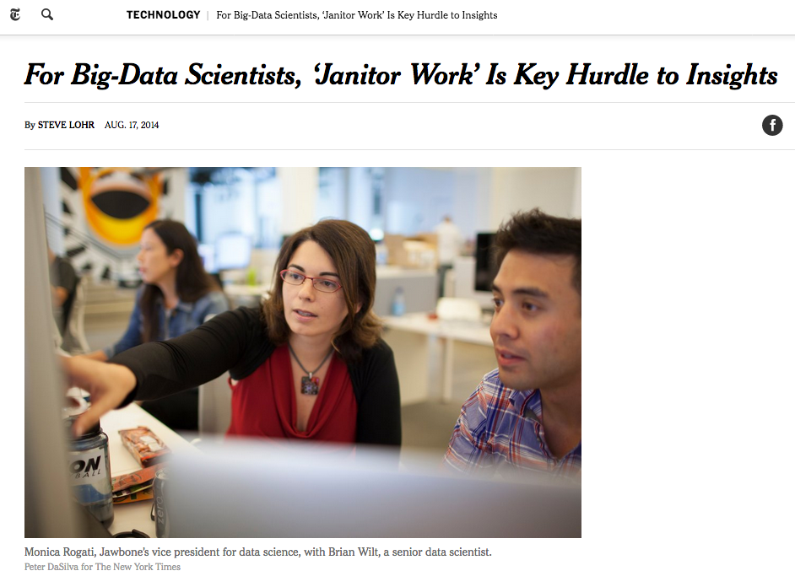
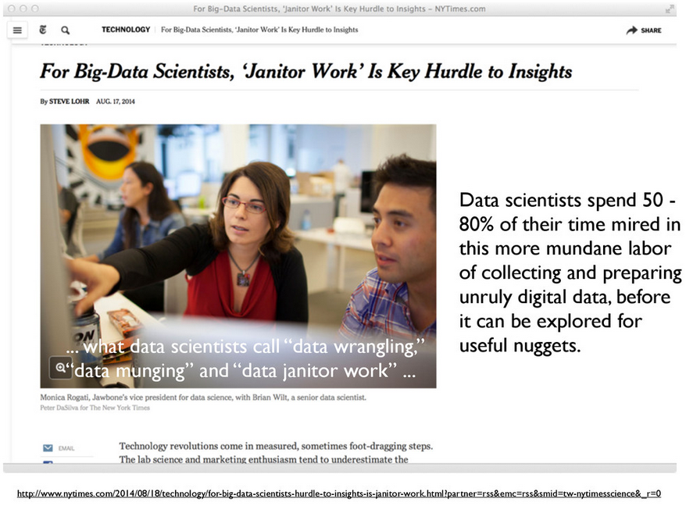
Data cleaning

Slide 17
Analysis and modeling
Formally the 80%
Computational developments have made this much easier
And led to an explosion in new methods and tools

Slide 18
Science bottlenecks

Slide 19
Different ways for data to be “big”
Volume
Variety
Velocity

Slide 20
Volume

Slide 21
Data visualization
Today the visualization component has become a bottleneck
To often visualization becomes only an end-product rather than an exploration tool
A problem because visualization is a quick way to spot errors
Fox & Hendler (2001): doi:10.1126/science.1197654

Slide 22
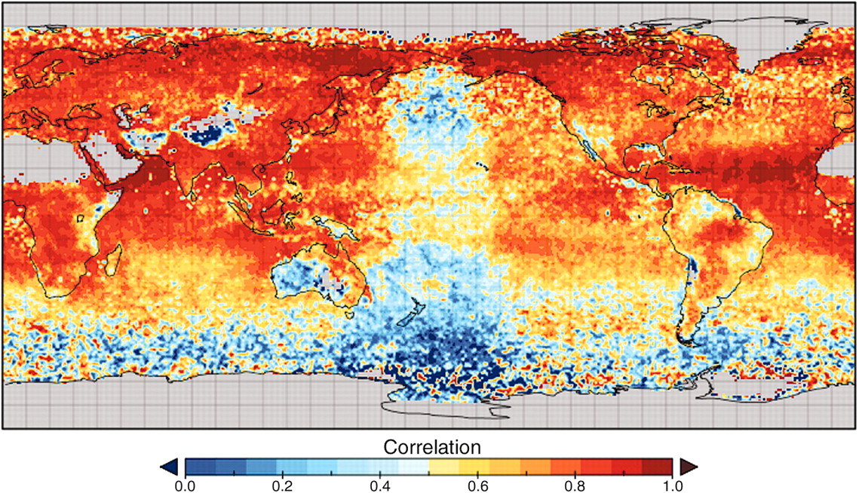
Fox & Hendler (2001): doi:10.1126/science.1197654

Slide 23
Variety

Slide 24
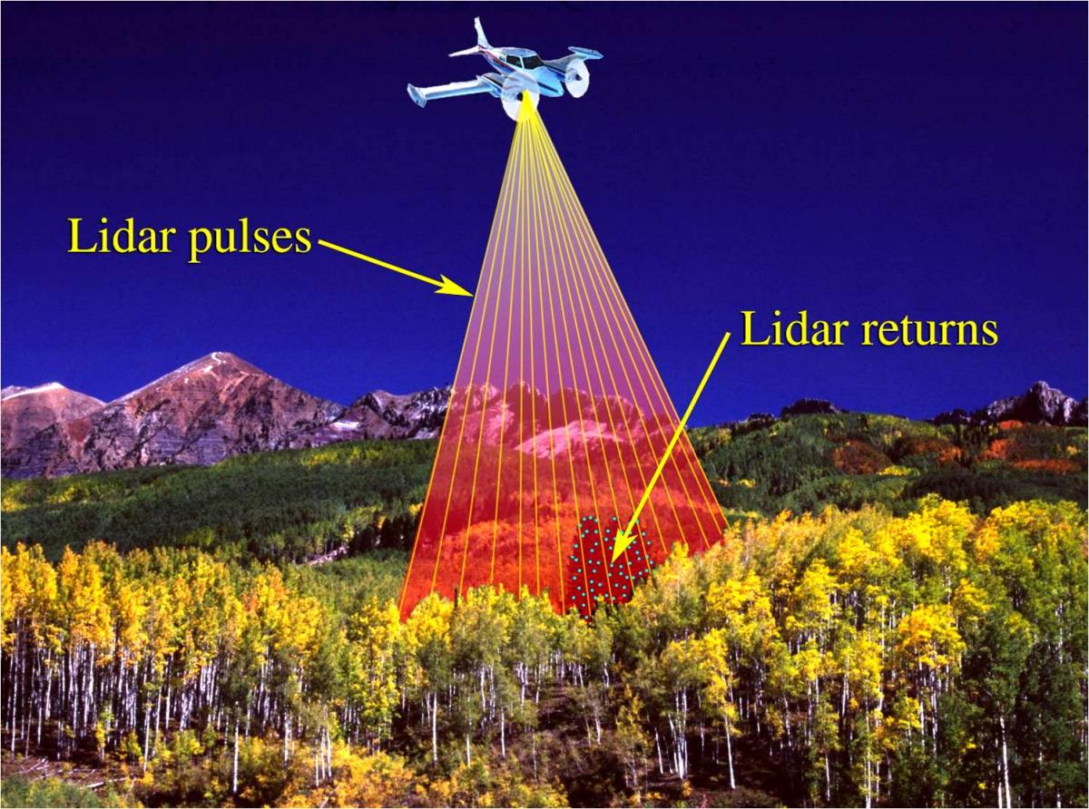

Slide 25
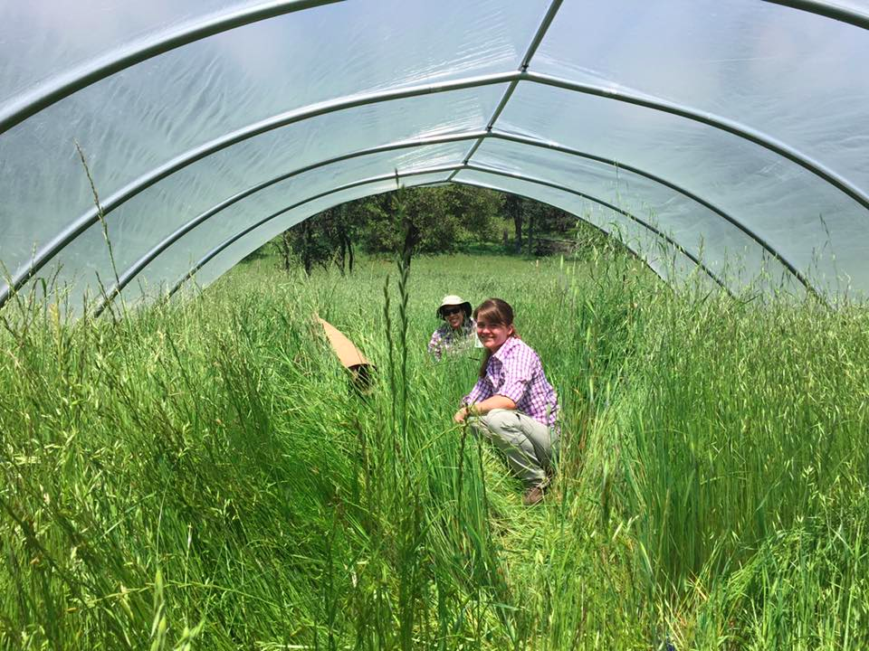

Slide 26

Vertically integrated data repositories

Slide 27

Limits to vertical integration

Slide 28
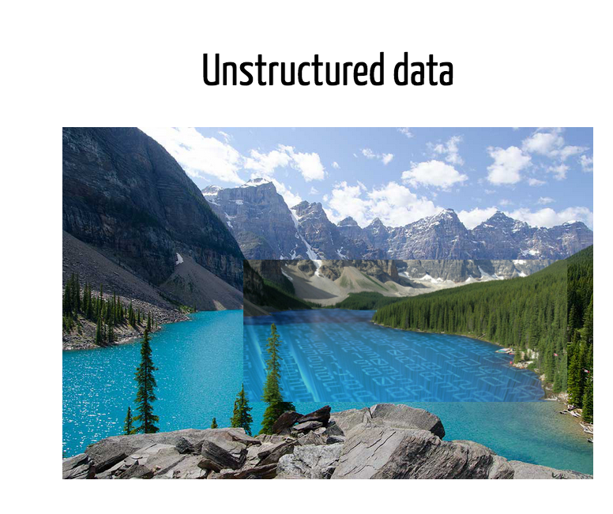

Slide 29
Velocity

Slide 30
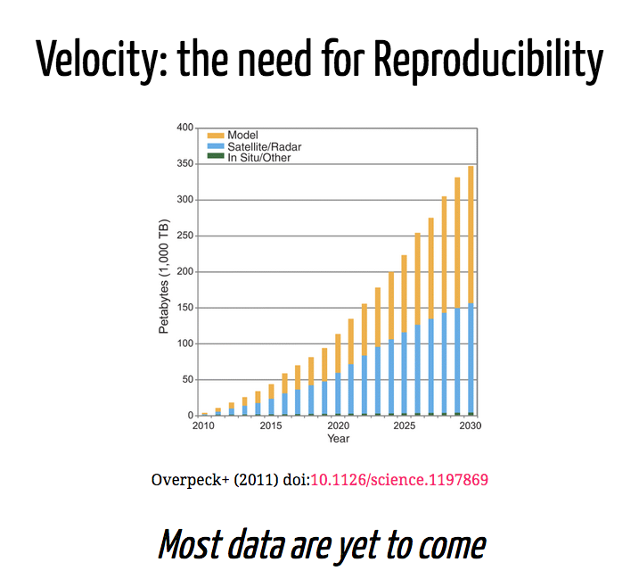

Slide 31
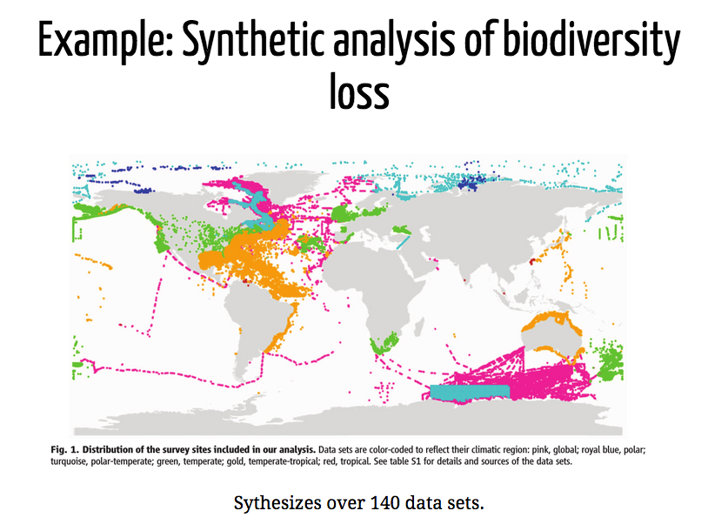

Slide 32
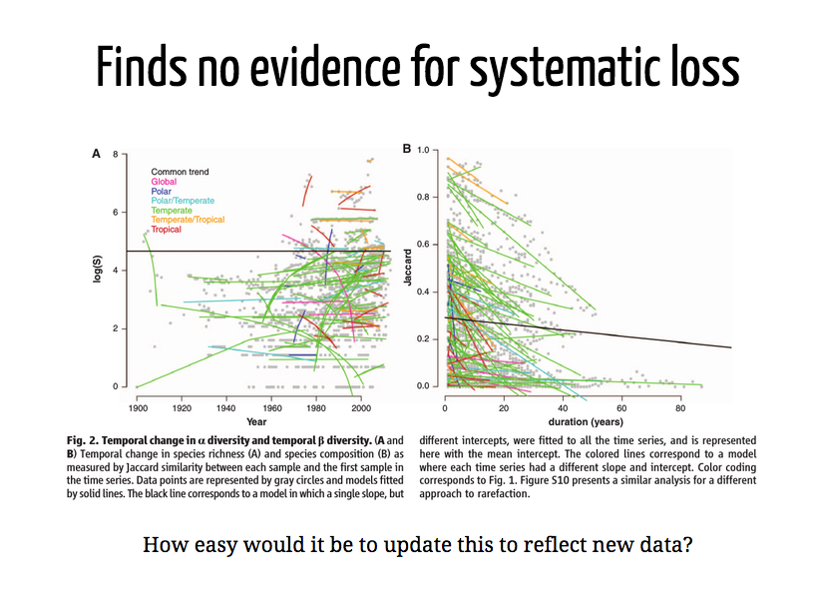

Slide 33
Reproducibility: Important for other reasons as well

Slide 34
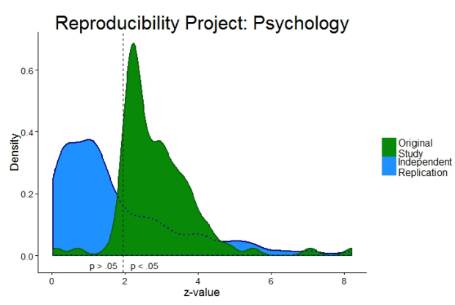

Slide 35
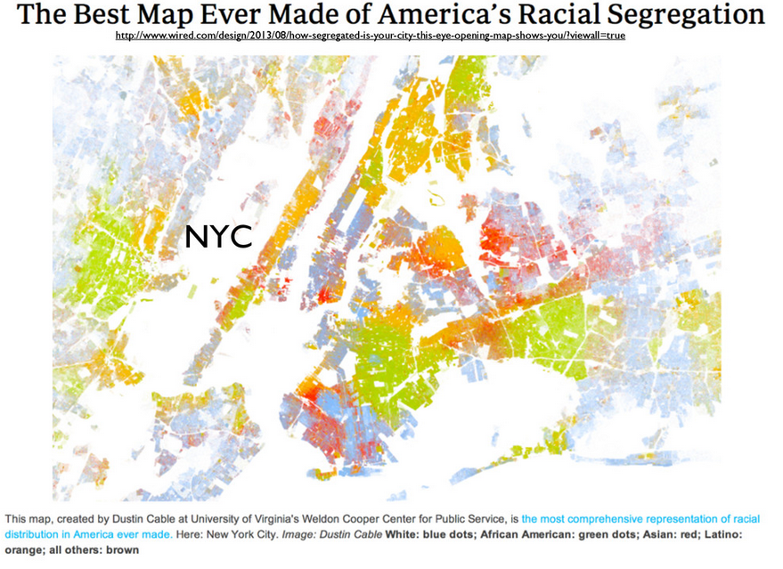

Slide 36
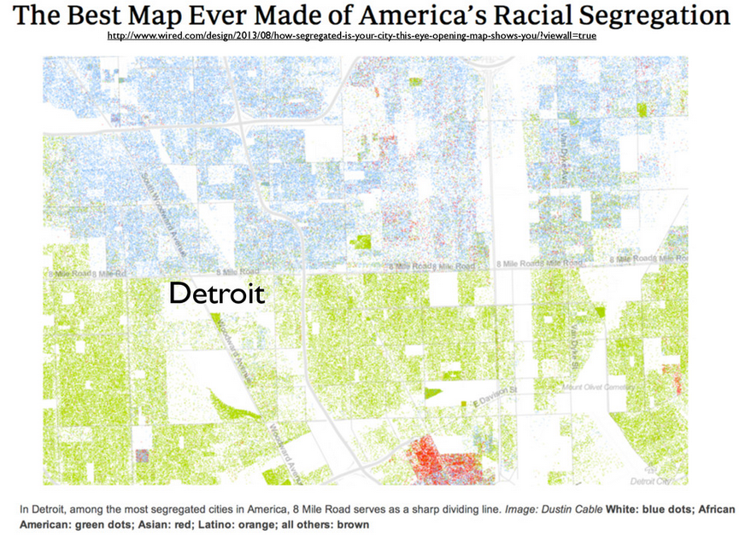

Slide 37
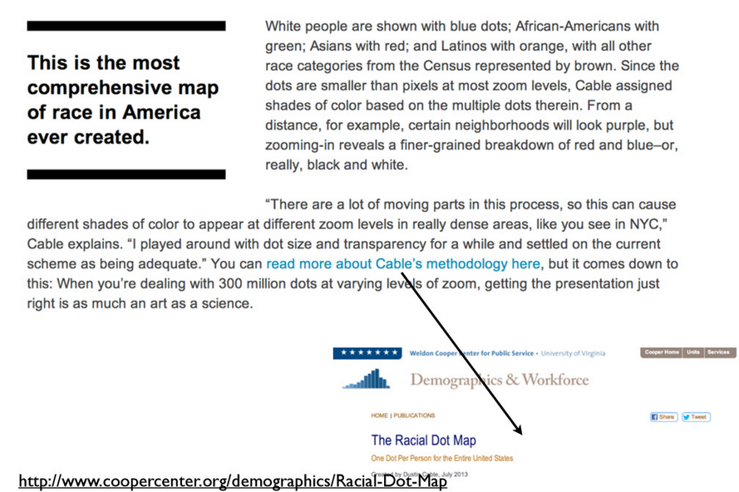

Slide 38
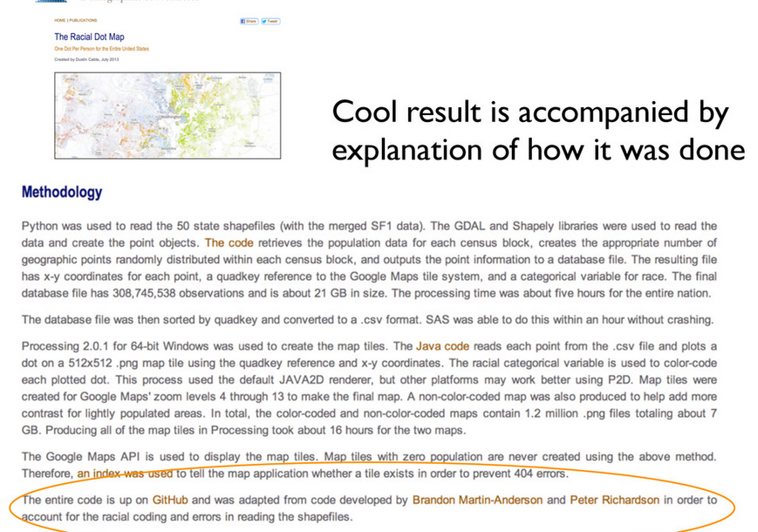

Slide 39
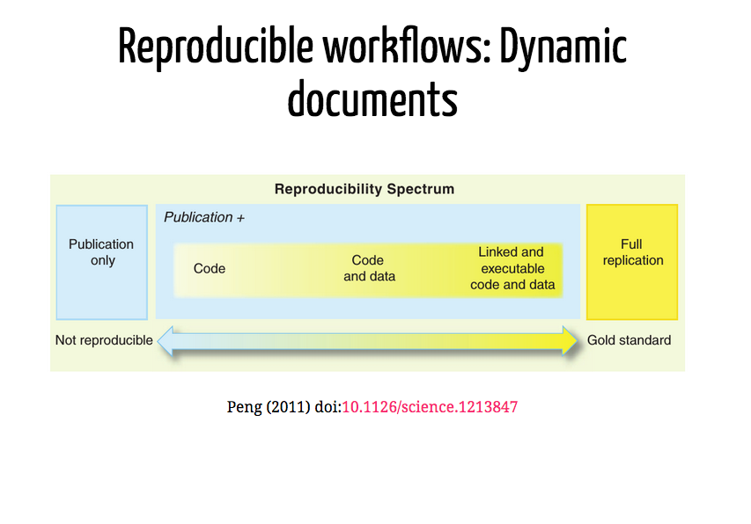

Slide 40
This course:
Real data, real tools
Things will break
Things will change

Slide 41
This course:
Some things will be in keeping with good pedagogy:
We’ll start with graphs first
Active learning
Some things aren’t:
We’ll jump forward and back at times
Starting at the deep end

Slide 42
How we’ll do it:
Different modules in which we transition from learning and coding as a class to independently
Frequent practice via four problem sets
An independent project in which you go from raw data to a reproducible final report
A free online text to help you along! https://r4ds.had.co.nz/

Slide 43
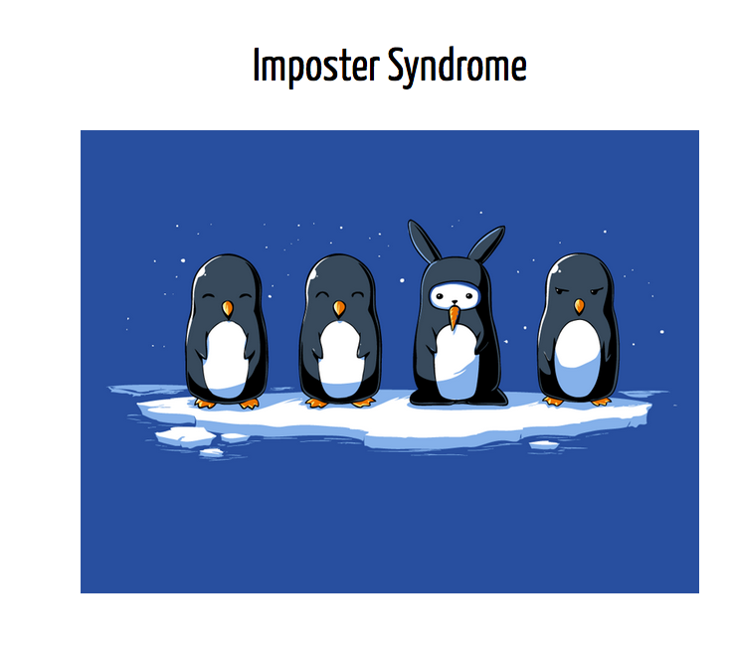

Slide 44
Language: Why R?
Scripted languages allow reproducibility
Not about technical attributes
Pick your language based on what people in your area speak/code
Rstudio, Rmarkdown and other tools for communication and sharing
A great open-source community (on that note - thanks to Carl Boettiger and Jenny Bryant for many of todays slides)

Slide 45
Exploratory data analysis exercise
Goals for this exercise:
Highlight the value of plotting our data before we analyze it
Get to know one another
Viscerally appreciate how much easier R will make our lives!

